Slide 1

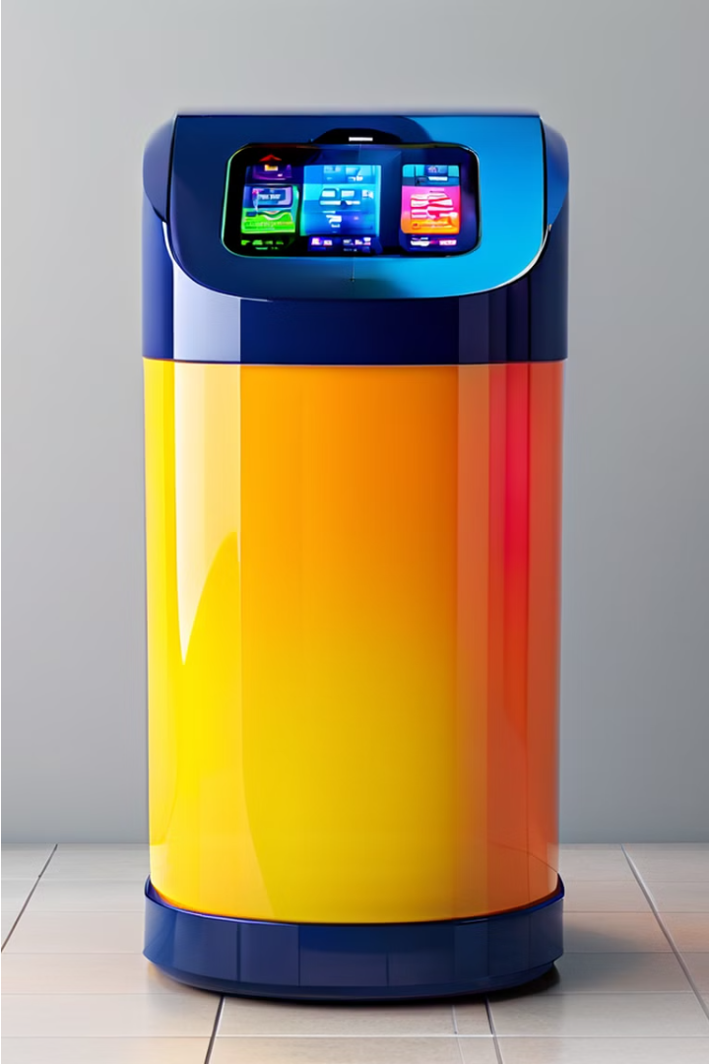


Smart Dustbin with Capacity Monitoring
Introducing a revolutionary waste management solution that combines sensor technology and real-time capacity monitoring to revolutionize how we manage our waste. This smart dustbin is designed to optimize efficiency and reduce environmental impact.
by PRAGADEESH S

Slide 2

Introduction to the Smart Dustbin
The smart dustbin is an innovative solution designed to revolutionize waste management. Equipped with advanced sensors, this intelligent bin can automatically monitor and track its fill level, providing users with real-time data on the amount of waste it contains. By harnessing the power of technology, the smart dustbin aims to streamline and optimize the waste collection process, making it more efficient and eco-friendly.
At the heart of the smart dustbin lies a sophisticated capacity monitoring system that utilizes cutting-edge sensors to detect the volume of waste. This data is then relayed to a connected app or dashboard, allowing users to monitor the fill level and plan their waste disposal routines accordingly. With this innovative technology, users can avoid overfilling bins and ensure timely emptying, contributing to a more sustainable waste management ecosystem.

Slide 3

Importance of Efficient Waste Management
Effective waste management is crucial for maintaining a clean, sustainable, and environmentally-friendly society. Improper waste disposal can lead to serious health and environmental problems, such as the spread of diseases, pollution of air and water sources, and the depletion of natural resources. By implementing smart and efficient waste management systems, communities can significantly reduce their environmental impact, conserve valuable resources, and create a healthier living environment for all.
Furthermore, effective waste management supports the circular economy by enabling the recycling and reuse of materials, reducing the need for landfills and incineration. This, in turn, contributes to the sustainability of our planet and helps mitigate the effects of climate change. Sustainable waste management is a key component of creating a more sustainable future for all.

Slide 4

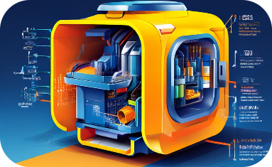

Features of the Smart Dustbin
Intelligent Sensors
Capacity Monitoring System
User-Friendly Monitoring
The Smart Dustbin is equipped with advanced sensors that continuously monitor the fill level of the bin. These sensors use cutting-edge technology to precisely detect the amount of waste accumulated, providing real-time data on the bin's capacity.
At the core of the Smart Dustbin is a sophisticated capacity monitoring system that tracks the bin's fill level. This system utilizes a combination of weight sensors and volumetric sensors to accurately measure the amount of waste, ensuring efficient waste management.
The Smart Dustbin's capacity monitoring system is seamlessly integrated with a mobile application, allowing users to easily track the fill level of their bin. This empowers users to optimize their waste disposal routines and ensures the bin is emptied at the right time.

Slide 5
How it works (detection of waste levels)
Sensor Detection
1
Strategically placed sensors continuously monitor the waste level
Capacity Tracking
2
Sensors detect when the bin is approaching full capacity
Smart Notification
3
Users are alerted when the bin needs to be emptied
The smart dustbin utilizes an advanced sensor system to continuously monitor the waste levels inside the bin. As the bin starts to fill up, the sensors detect the increasing volume and trigger notifications to alert the user when the bin is approaching full capacity. This allows for proactive waste management and ensures the bin is emptied in a timely manner, preventing overflow and improving efficiency.

Slide 6
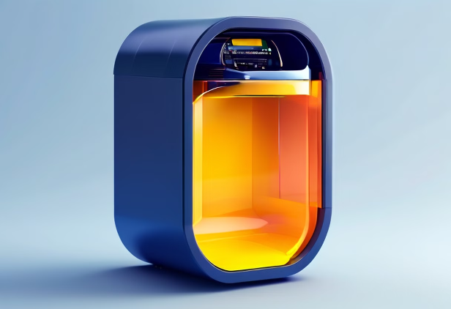
Visual representation of how the capacity monitoring system works
The smart dustbin's capacity monitoring system utilizes a series of sensors strategically placed throughout the bin. These sensors continuously track the fill level, detecting when the waste reaches certain thresholds.
As the bin fills up, the sensors relay real-time data to a connected mobile app or web interface. This allows users to easily monitor the dustbin's capacity and receive alerts when it's time to empty it.

Slide 7

Explanation of how users can track the fill level
The Smart Dustbin's capacity monitoring system provides real-time updates on the fill level through a user-friendly mobile app. Users can access a visual representation of the dustbin's status, with a clear indicator showing the current percentage of capacity filled. This allows them to easily monitor the dustbin's usage and plan their waste disposal accordingly.
Additionally, the app can send notifications to users when the dustbin is nearing capacity, enabling them to schedule timely emptying or collection. This streamlined tracking of fill levels helps optimize waste management, ensuring the dustbin is emptied efficiently and reducing the risk of overflow or unsanitary conditions.

Slide 8
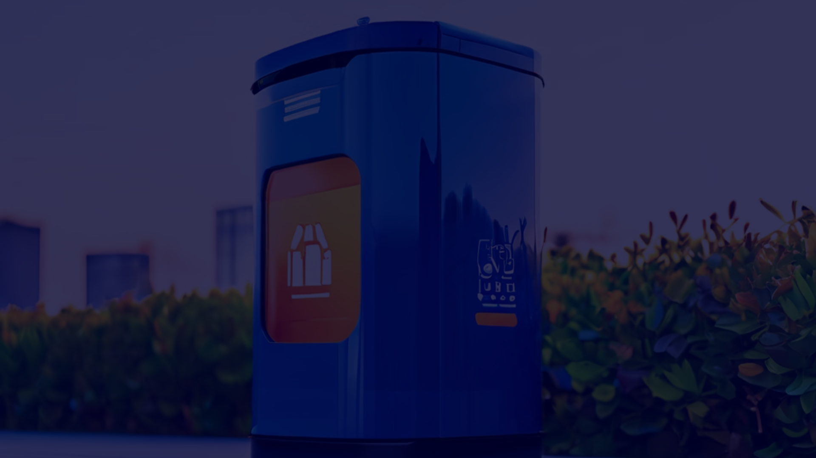
Benefits of Smart Dustbin
1
Improved Waste Management Efficiency
2
Reduced Environmental Impact
3
Enhanced User Experience
The real-time fill level notifications empower users to better plan their waste disposal, reducing the likelihood of overflowing bins and creating a more convenient and hygienic waste management experience.
The smart dustbin's capacity monitoring system helps optimize waste collection routes and schedules, leading to more efficient and cost-effective waste management for municipalities and businesses.
By tracking fill levels and enabling timely waste collection, the smart dustbin helps reduce the number of unnecessary truck trips, lowering greenhouse gas emissions and fossil fuel consumption.

Slide 9

Improved Waste Management Efficiency
The integration of the Smart Dustbin's capacity monitoring system can significantly improve the efficiency of waste management. By continuously tracking the fill level of each dustbin, municipalities and waste management providers can optimize their collection routes and schedules. This real-time data allows them to dispatch collection trucks only when necessary, reducing unnecessary trips and fuel consumption. As a result, the overall efficiency of the waste collection process is enhanced, leading to cost savings and reduced environmental impact.

Slide 10

Reduced Environmental Impact
The Smart Dustbin's capacity monitoring system not only improves waste management efficiency, but also has a significant positive impact on the environment. By enabling users to track their waste levels in real-time, the dustbin encourages more mindful and responsible disposal habits, reducing the amount of waste that ends up in landfills or oceans. This, in turn, helps conserve natural resources, minimize greenhouse gas emissions, and protect delicate ecosystems. Additionally, the data collected by the dustbin can be used to optimize waste collection routes, further reducing the environmental footprint of waste management operations.

